Slide 1

From disparity to depth on mobile stereo cameras
Paz Ilan
CP supervision : Dr. Gal Shabtay
TAU supervision: Prof. Shai Avidan

Slide 2
Executive Summary
The focus of the research
Analyzing the issues involved with converting disparity to depth in mobile stereo cameras
Approach
Check various factors effects on the disparity
Try to formulate and check solutions for the issues
Results
Reduction of relative error from 30% to 4.5% under some strict limitations

Slide 3
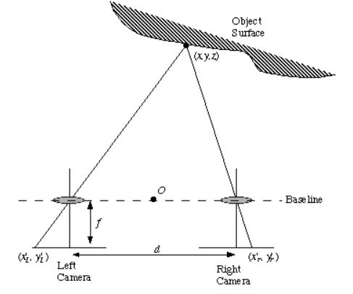
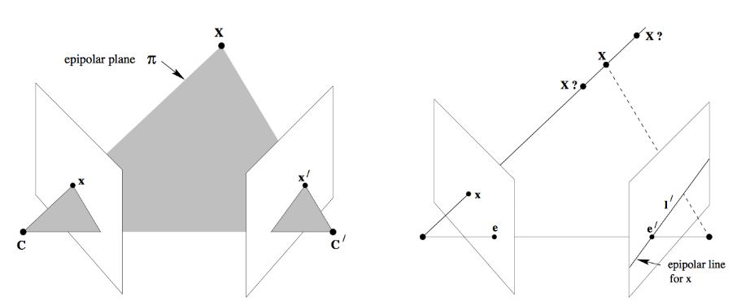
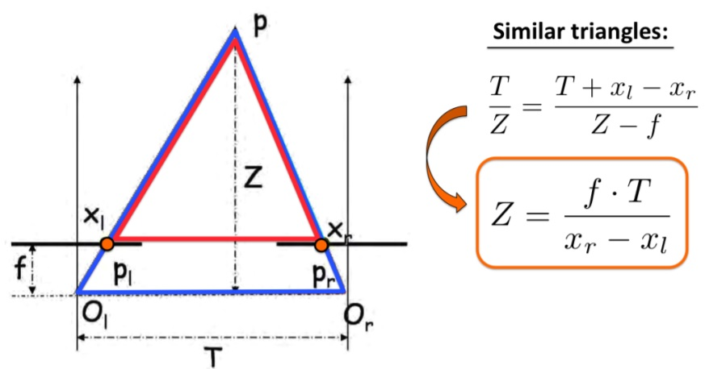
Disparity relation to depth
Notes:
- General disparity theory, inverse linear connection in the canonical case
General case:
can use epipolar geometry to form a more complex connection (i.e. essential/fundamental matrix)
Normal use case – rectification using an external set of calibration parameter into the canonical form.
Since we want to use a pair of stereo images and find the depth in the image we first need to show the connection between the two. We will first examine the canonical case in which both cameras are entirely parallel to one another. As we can see from basic geometry, we can derive a simple reverse linear relation between the disparity of a point between two images and the point’s actual depth. The relation is based on a pinhole module for each camera and the assumption of fixed and equal intrinsic camera parameters for both cameras.
In the non-canonical case we can derive a more complicated relation using epipolar geometry as show in the left image on this slide. However, as is common practice, we can use an external calibration procedure to rectify the non-canonical case into the canonical one and use the simple relation we have seen in the previous slide as depicted in the right image in this slide.

Slide 4
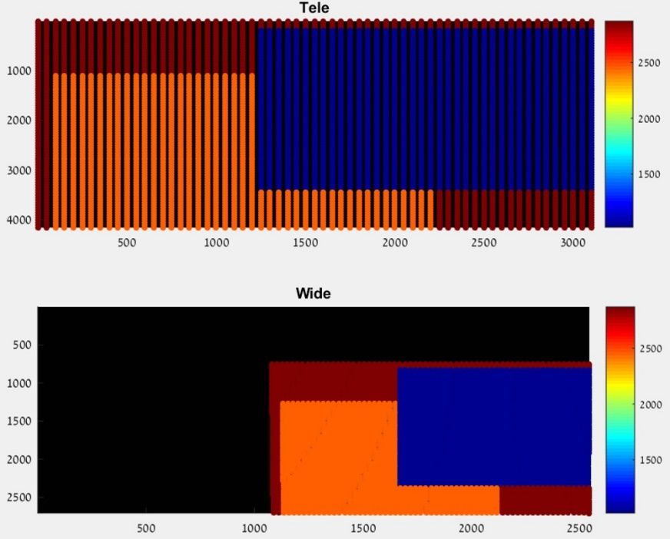
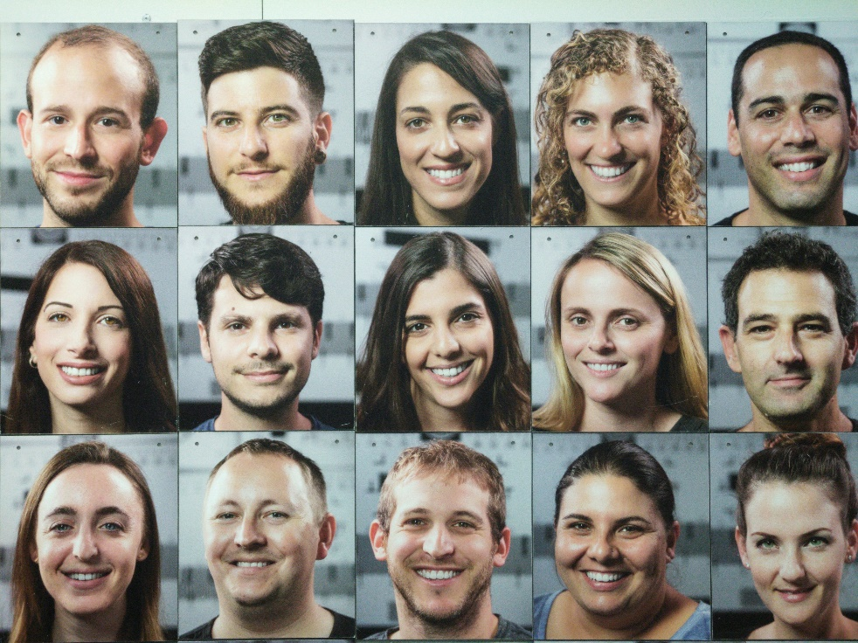
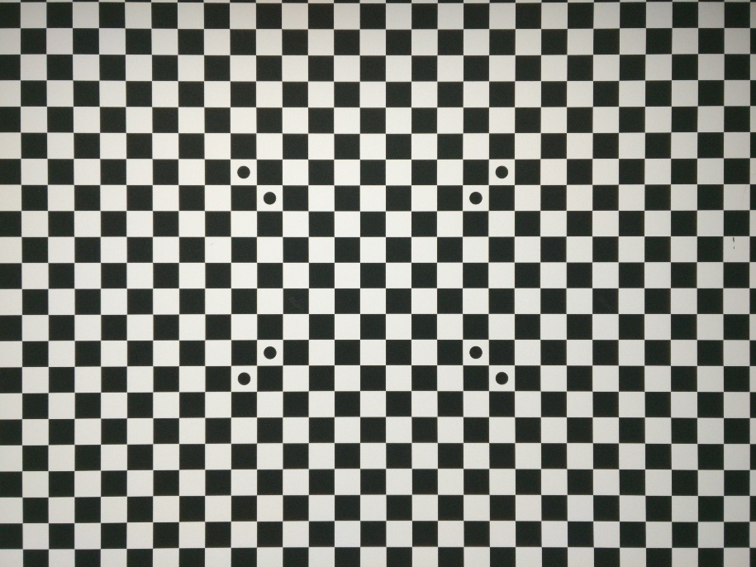
Physical experiment setup
Theoretical simulation
Dual modules used
Without folded optics ,wide + tele
With folded optics, wide + tele
Simulation environment to check hypothesis validity
Faces Chart
Chessboard
Feature extraction and matching
Rectification of Features
Disparity calculation
Notes:
Physical setup:
Modules used – folded (3x) and not folded(2x)
Charts used – chessboard (uniform spread, robust features, easy matching), face chart (IPD set to 6.5cm manually, used mostly for a learned fix)
Processing included – extraction + matching->rectification on features (for efficiency)->disparity calculation
Theoretical simulation environment:
Randomized rectangles chart at chosen amount of depths on Tele and converted to wide according to calibration parameters.
Allows simulation and isolation of specific factors to check hypothesis in a clean environment.
In order to check the disparity to depth conversion on actual mobile phone images we performed various physical experiment using two specific charts under different conditions as will be elaborated in the analysis phase. The charts were either a flat chessboard chart that allows for a uniform point distribution with high accuracy, or a face chart which enables us to use facial size measurements such as IPD (the images were designed to make sure the IPD fits the theoretical mean) as we will explain later.
In each experiment we performed a similar process. Extracting significant features (for the chessboard it was the corners between squares and for the face chart it was facial landmarks) and matching them between the two different images, performing rectification on the feature points (for time efficiency) and calculating the resulting disparity.
To examine our theories, a theoretical work environment was constructed to allow isolation of outside influences on the results. In this environment we simulated several charts at different depths by randomly choosing several rectangles and their respective depths. The initial scene is simulated in the tele image and then the image coordinates are converted to world coordinates according to the generated depths and locations. The world coordinates are then converted to the wide image coordinates. All coordinate conversions were done using the calibration parameters of the specific module we are simulating. The scene can be simulated across multiple frames adding handheld movements along with a random scale to simulate handheld refocuses.

Slide 5
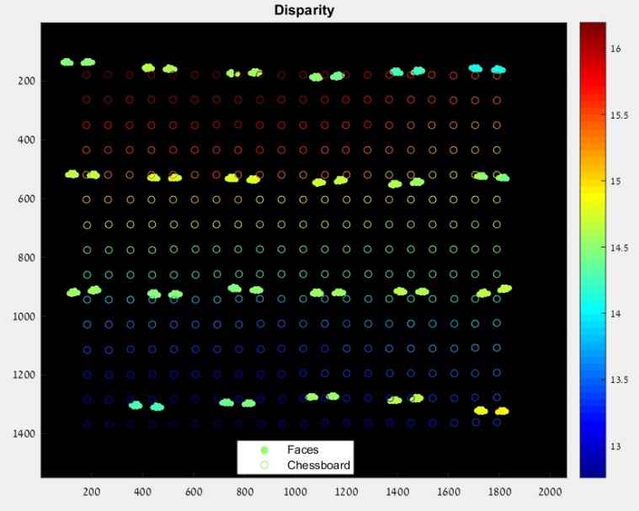
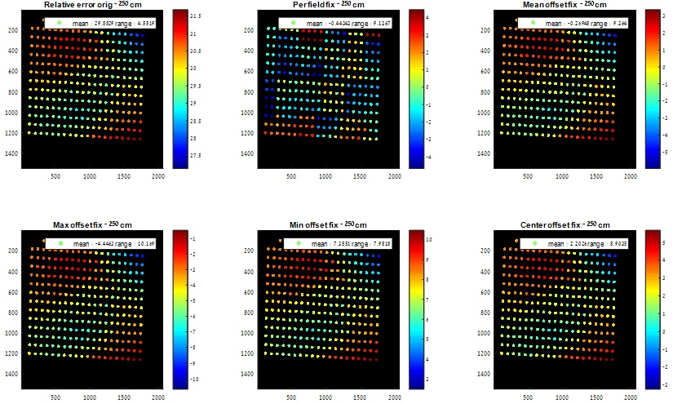
Main issues
Disparity values differ between different experiments.
Disparity values differs from theoretical expected value.
Notes:
Initial experiment showed poor performance:
The accuracy from converting the disparity according to the calibration parameters is low – we can’t get a decent estimation. This could be due to issues with calibration (close chart, 3D chart, etc…) or other issues we will explore later on.
The repeatability between different experiments is low – even if we fix the above, we can’t apply it again since it isn’t the same fix. As we can see on the left side, a face chart and chessboard chart at the same depth with the same module – widely different disparities.
We performed several initial experiments and got very low depth estimation accuracy as well as different results for the same experiments done at different times. In this slide we can see the results of a face chart and chessboard chart taken at different times, at the same distance with the same module. As we can see, we can hardly even notice that the depth is the same from the disparity. Since the repeatability is the most important factor in any solution we come up with, we started investigating which factors effect it and tried to come up with possible fixes.
As we can see in the figure in this slide, even if the results are entirely repeatable, there is still a large error when trying to use the basic stereo theory for the conversion. This could be caused due to several different factors:
The calibration minimization function does not attempt to minimize the depth estimation from the stereo images.
The calibration process is done with only one focus distance, which is very close (60cm). This could be an issue for several reasons:
Close object's disparity is quite large anyway, so the relative error is small even for a set offset (which will not be the case for farther distances).
As we've seen in our investigations, the disparity results could vary between different refocusing, even for the same distance, so using only one focus attempt could be unstable.
Focus change effects are not linear with distance. For example, the change between 60cm focus and 120cm focus is much more noticeable than 120cm and 180cm. So taking only a very close focus distance could be a very bad estimate for the normal use case scenario since most natural images are taken at a farther distance, and the calibration parameters are effected by the focus but, as we mentioned before, are not adjusted to different focuses.
The temperature of the modules isn't regulated, i.e. the calibration isn't done with heated modules. We've seen how this could affect the disparity, and therefore the extracted module parameters.
Our calibration is done with a 3D chart that is not close to flat. This could be an issue as we've seen that the depth of the object has an effect on its scale and non-disparity axis error (which is a part of the minimization process).

Slide 6
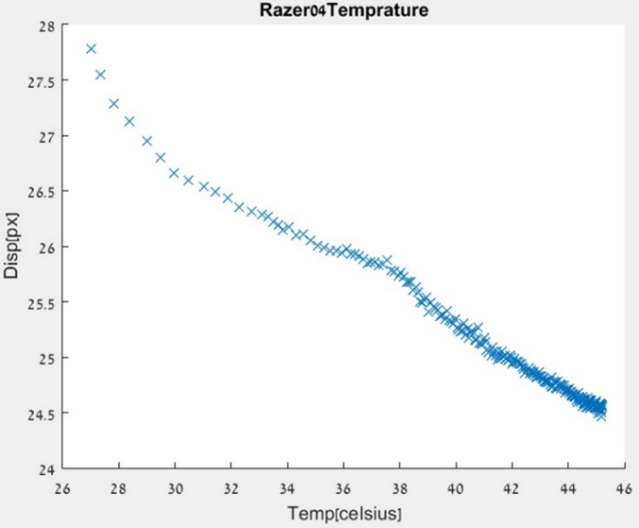
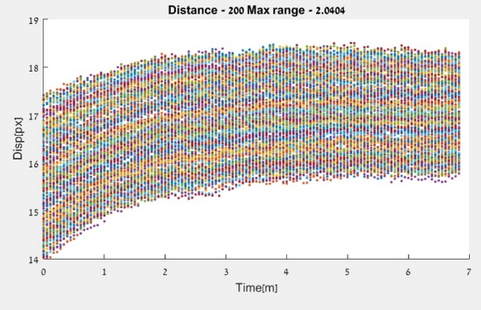
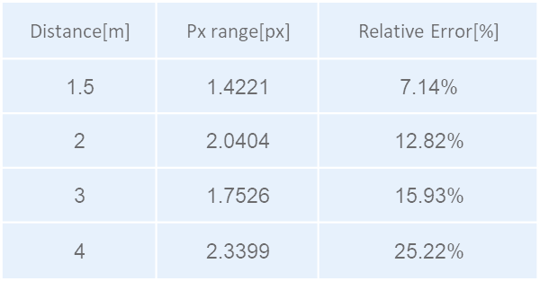
Heating
Heating of the device over time changes disparity.
Get additional temperature data from the module.
Pre-heat the module to reach the saturation zone.
Notes:
First investigated factor – heating:
On the unfolded module we had access to the module itself, so we checked the temperature and disparity and we can clearly see the trend.
On the folded module we checked the dependence between the disparity change and the distance – there is no clear relation.
Conclusions:
Heating exists in different modules.
Heating has a saturation zone after which the change is very small.
Change is not monotonic in distance.
Fix options:
Get temperature report from module – proved unreliable.
Work only with heated modules – in the saturation zone (after 3 mins of activity).
We first tested the effect of heating on our results. For that we took images over 10 minutes on a tripod with focus lock and compared the disparity values over time. We noticed that, for a given module, we get a change in the disparity values as a function of time. The right image shows the results of a tripod, flat scene, chessboard experiment done with a non-folded module with an attached temperature sensor directly to the camera modules. In this experiment we clearly see the connection between the temperature and the disparity.
The left image shows the result of the same experiment done with a folded module at several different distances along with the result summary in the table below.
The conclusions we draw from these figures:
The heating exists in different modules as well (the two experiments shown here are for folded and non folded, right and left accordingly).
The heating effect has a saturation zone, meaning that after some time that the camera has been active, the heating no longer changes the disparity significantly.
The change does not seem to be monotonic with the distance to the chart.
The first fix option we checked is the obvious one - get additional temperature data from the module. We investigated a bit and found out that the controller should have an internal temperature measurement (not absolute, but relative to a set point), using this measurement then allows the extraction of where we are on the temperature plot by comparing the temperature change over time. Unfortunately, this measurement proved unreliable in our setup so we couldn’t use it. Instead, we needed a different option, albeit with more constraints, to help with this issue - limiting our depth-from-disparity conversion to the temperature saturation zone in each module. For example, for the folded module it takes around 3 minutes in order to reach the saturation zone, so the experiments are held after the cameras are active for 3 minutes at least.

Slide 7
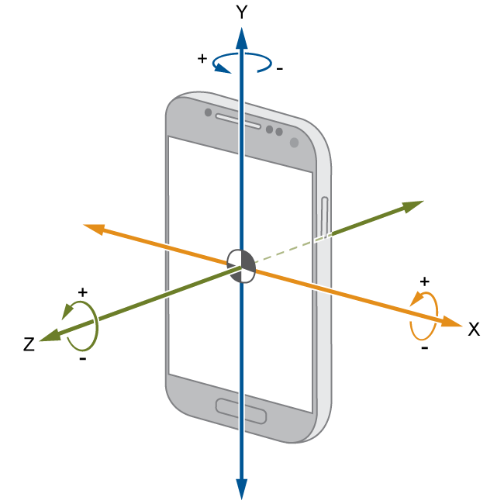
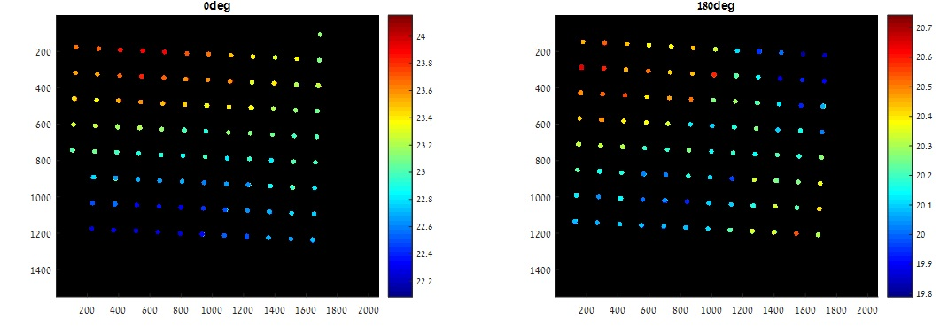
Device orientation
Device orientation changes disparity.
Use gyro information
Notes:
Next investigated factor – device orientation.
As we can see from the different pattens – orientation effects the results (probably due to gravity).
Fix: use gyro
In order to adapt to a real world use case, where the orientation of the phone could vary, we decided to investigate whether the phone's orientation effects our results.
In the figure in this slide we can clearly see its effect and the importance of addressing it.
The fix is simple, using the gyro information to determine the orientation as it has proven to be reliable.

Slide 8
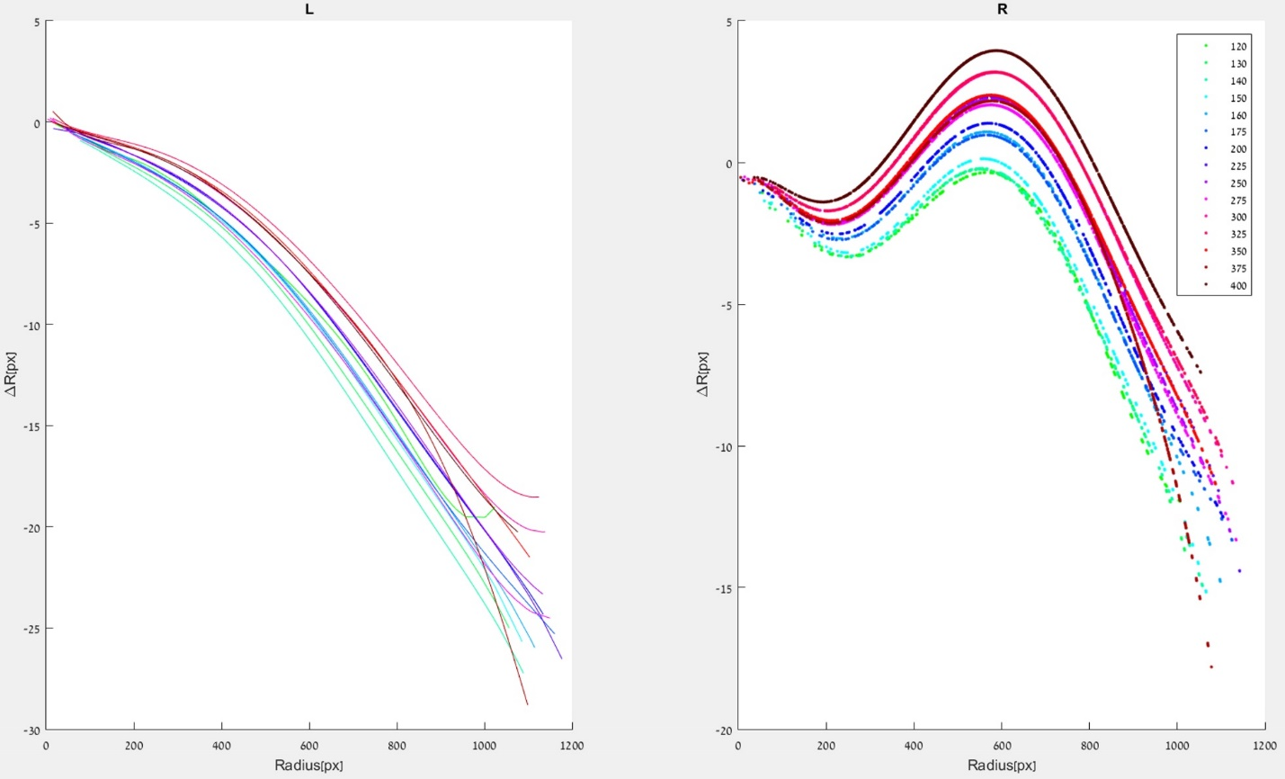
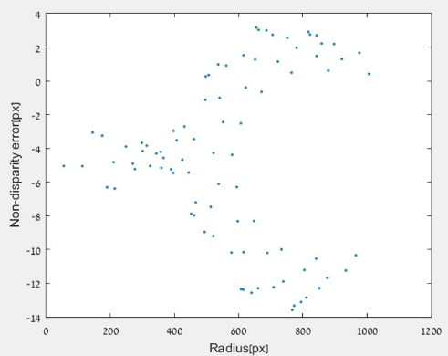
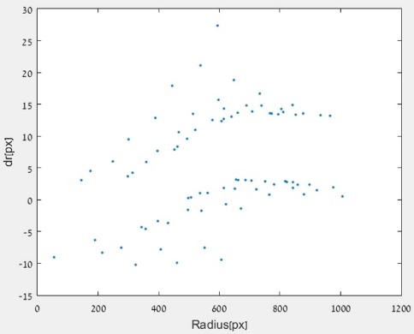
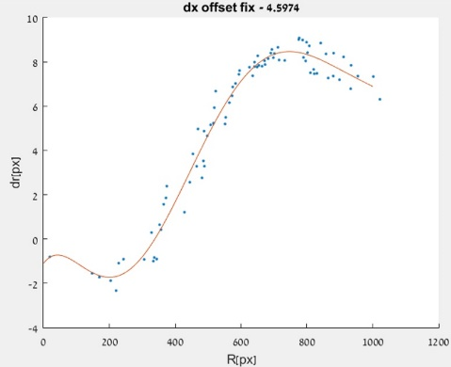
Distortion
Lens distortion causes change in the disparity across the sensor.
Use extra calibration steps to determine the lens distortion at each focus distance and apply the fix on the given image.
Use a distortion canceling rectification.
Add the odd degrees to the radial distortion polynomial.
Use the folded module that showed little to no residual distortion.
Use the non-disparity axis constraint:
$r_{wide}=\sqrt{x^{2}+y^{2}}$ $r_{tele}=\sqrt{{(x+disparity)}^{2}+y^{2}}$
Notes:
Next investigated factor – distortion
Even after the rectification there exists some residual distortion difference between the wide and tele, and it changes with the chart distance.
Reasons:
Tele only rectification method (to reduce processing time, avoid changing and cropping the wide image). Radius changes due to disparity.
Only even degree poly.
Focus changes disparity since the barrel and sensor change relative location.
Fix options:
Extra calibration steps.
Distortion canceling rectification (didn’t help much).
Add odd degrees (didn’t help much).
Use folded module that showed little residual distortion (due to optical properties and smaller overlapping FOV).
Non disparity axis constraint (last attempt to avoid using only the folded module):
After rectification, non-disparity axis should theoretically be 0 or constant. Try to find underlying radial pattern that causes deviation.
Separated error to radial and tangential components (2nd fig), still no radial trend. Added optimization function that adds offset, finds optimal radial trend and minimizes point distance from this poly->clearly see a trend (3rd fig).
During our investigations we noticed that there is some radial error pattern existing in the disparity. This could be due to radial distortions existing in the images even after they have been rectified. The plots on this slide show the residual distortions found on our non-folded module at different distances for each image separately. We can see that they don’t seem to be the same distortion and that they change with the different distances and the worst-case deviation is up to 10 pixels.
A few possible reasons for this:
The rectification method used tries to convert the tele image’s lens distortion into the wide image’s lens distortion (to reduce processing time and avoid changing the wide image). This causes an issue, as some items that appear in some radius X in the wide image, are by definition not in the same radius in the tele image even for fully canonical cameras since $r_{wide}=\sqrt{x^{2}+y^{2}}$ and $r_{tele}=\sqrt{{(x+disparity)}^{2}+y^{2}}$ (apart from objects that are far away enough from the cameras so that the disparity is ~0). This isn't a major issue usually, as the difference in radius isn't large, but due to our very small baseline we need close to sub pixel accuracy to get a "good" relative error.
The representation of the radial distortion is done only with the even degrees for a radial distortion polynomial. This is common practice in most calibration schemes we know of. This representation of the distortion could be insufficient for some modules.
Focusing – focus change is achieved by moving the barrel away/towards the sensor. This, by definition, changes the distortion in the image from the distortion found in the calibration process that was applied in a specific distance. The image in this slide supports it as it shows the distortion of the tele image change with the focus distance.
The brute force fix option is to use extra calibration steps to determine the lens distortion at each focus distance and apply the fix on the given image. This method is less desirable as it adds phases to the calibration process, which is not an optimal solution for mass production.
Instead, we tried switching to a rectification mode that cancels the distortion for both cameras. This seemed to have helped, but not by much.
Next, we tried adding the odd degrees to the radial distortion polynomial and by this enabling a more complex model for the distortion that better represents the real distortion. This also seemed, which indicated that the original distortion was indeed more complex than the even degrees only form, but was still insufficient (this didn’t address the focus effect on the distortion for instance).
Another option is to simply use our folded module, which showed little to no residual distortion, due to its decreased FOV overlap with the wide image and improved optical properties.
After all the "easier" fixes above were either inefficient or didn’t help enough, we looked for another way to fix the residual distortion before resorting to using the folded module explicitly. In order to do that, we decided to use the non-disparity axis in order to find a correction for the distortion. This follows from the fact that after the rectification, the non-disparity axis error should be close to 0 and mostly the same for any depth (since there is only a very small translation in that direction). This has the benefit of not adding phases to the calibration process and not being dependent on the scene type (flat or depth).
We examined the non-disparity axis error as a function of image radius, and then we converted the error to radial error. The resulting graph (middle figure) did not look to have a polynomial radial trend. To expose the trend we added an offset in the non-disparity axis. The result reveals a polynomial relation. Therefore, we used a minimization function that minimizes the difference from the best polynomial fit of dr to the data, to find the best offset and got the plot that we can see in the rightmost figure.
As we can see, we can certainly use the non-disparity error in order to fix the residual distortion using the method defined above to remove any additional error caused due to the distortion.
The fix suggested here was theoretically useable for any general scene, but for our folded optics, due to the mechanical properties which we will discuss later, there is a dependence between the non-disparity axis error and depth so we had to resort to using the easier, less accurate fixes we mentioned before.

Slide 9
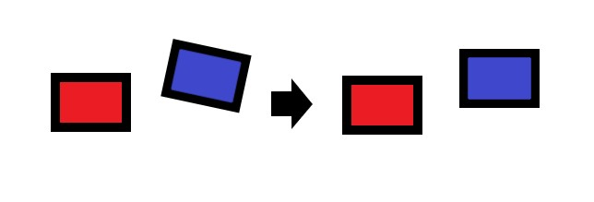
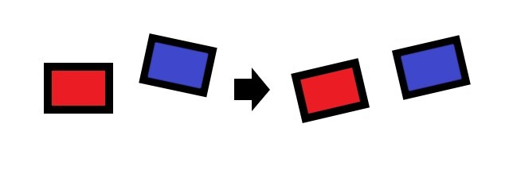
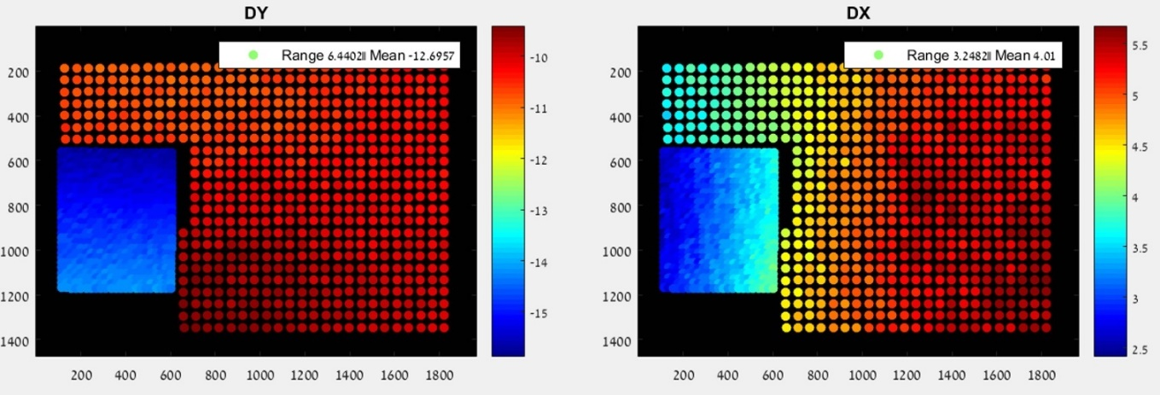
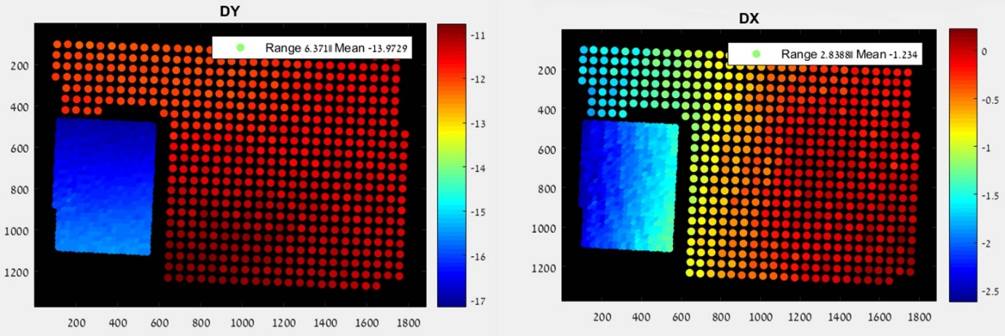
Non baseline translation
Translation in the non-baseline axis effect creates a dependence on depth.
Rotate images to be completely parallel.
Notes:
Next investigated factor – Non baseline translation
Normal rectification method performs as illustrated in the left (save processing time on wide and avoid the need to crop it).
Normal use case – this is good enough, in our case (sub pixel accuracy needed) this might be an issue. This also inhibit the non-disparity axis fix we mentioned before.
Dual depth experiment, on the left we can see that the non-disparity axis changes with depth (DX).
Fix: Rotate completely as illustrated on the right. We can see the results below, the trend seems more continuous between the two chart, the color scale is smaller and the mean is closer to 0.
Our usual rectification method, removes the rotation between both modules but it does nothing to help with the translation. In the case that the only translation between the modules is the baseline, this is not an issue, but when we are dealing with the real world scenario and especially with mobile cameras, the tolerances for shifts in the non-baseline axis are small but not negligible. For most applications this is not a major issue, since it doesn't have a large impact. However, in our case, since the baseline itself is small and the required accuracy is high, this could potentially be an issue and we wanted to investigate its impact. Theoretically, translation in the non-baseline axis as illustrated above should simply add disparity in that axis on top of the usual disparity. This could cause issues with the fix we suggested for the distortion before. The translation in the Z axis should, theoretically, cause objects at different depths to have different scales, which is quite a major issue. When combined with additional scale issues that will be addressed later on the problem increases and we will discuss it further then.
To fix the translation in the non-disparity axis (not in the Z direction) we rectify the images so that they are truly canonical. In order to do that we need to calculate the added rotations from the translation found by the calibration process and rectify the images accordingly.
In the figure we can see the result of using the fixed rectification on a scene with two charts at different depths. We can see that before the fix was applied the non-disparity axis error seemed to be different between both charts. We didn't expect the value to be zero or even constant (due to the many other issues we elaborate on later), but if the non-disparity axis was indeed negligible, we expected the trend to be the same on both chart in the same section of the sensor, meaning independent of object depth. Since this is clearly not the case, we can assume that there is indeed an impact of the non-disparity axis translation.
The results after the fix seem slightly better, the non-disparity axis seem to continue with its trend even to the different chart (the colors are a bit more similar and the range is a bit smaller as well) and the mean value is indeed closer to 0. This indicates that the non-disparity translation does play a certain factor, and if we want to use the non-disparity axis fix we mentioned previously, we will need to apply the fix mentioned here before trying to use it.

Slide 10
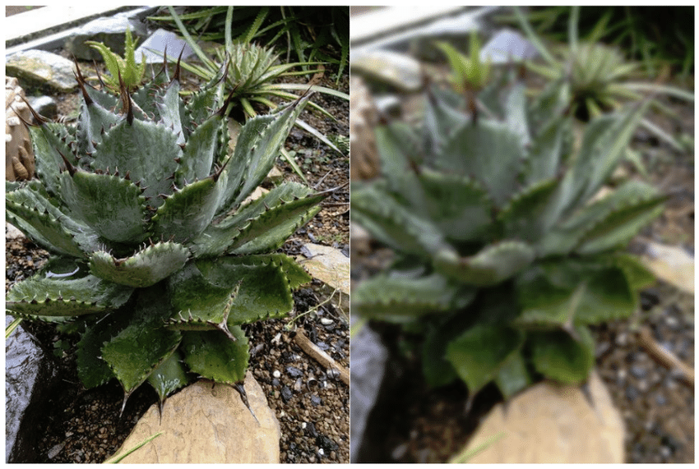
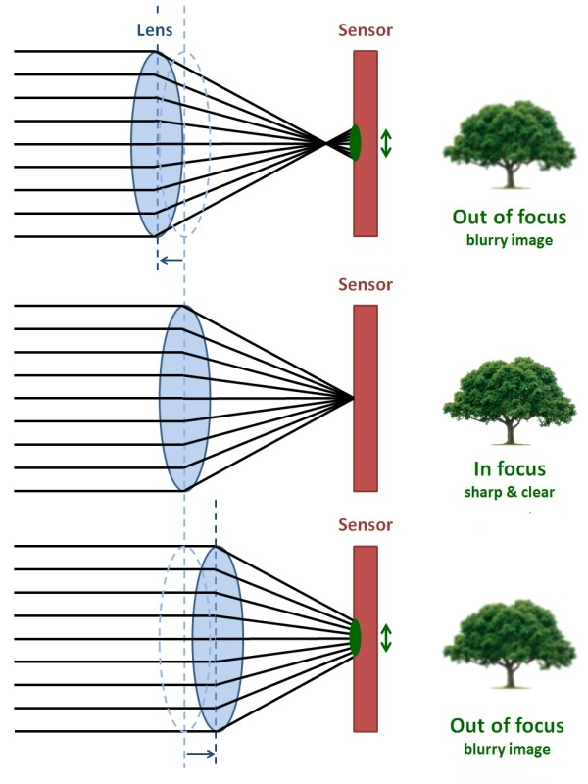
Focus fail
Focus fail causes inaccurate localization of features and false matching.
Focus metric to disqualify scenes.
Use manual focus for predetermined range of working distances.
Notes:
Next investigated factor – Focus
We divide focus issues to 3 problem sets, focus fail, wide to tele focus mismatch, and focus repeatability.
First issue – focus fail.
Issue to locate and match features entirely, especially when sub-pixel accuracy is needed.
Fix options:
Use focus metric to disqualify scenes.
Use manual focus and only work on a predetermined range of working distances.
One of the main issues we have regarding any variation of a learnable fix to disparity is repeatability, as we explained at the start of this chapter. In order to improve the disparity repeatability of our cameras we investigated the focus's effect on it. Since each camera has an independent focus mechanism, it is entirely possible to have different focus position for each of them. Having a different focus positions has direct influence over the disparity. It produces a different scale for each image, which in turn causes objects at the same distance to have different disparity values in two different wide-tele image pairs. A trivial fix for this would be to get the reported focus position from the cameras, but according to our experiments its very unreliable so we decided to divide the focus issue into three separate categories and attempt to solve each one separately.
This is the case where one or both cameras have entirely missed the focus distance for the desired object. This case is a major issues for us since extraction of features in blurry images is very unreliable and definitely not sub-pixel accurate, as we require due to our small baseline.
Fix options:
Define a focus metric of our own or use the score from the existing one in the module. This solution is not feasible since defining a focus metric is a project in its own right, and we can't get access to the focus metric score of the module.
Use manual focus - a predetermined focus position that will handle the normal use case for most photos. This way we can ensure that the focus miss will only really occur to items that are very close to the camera, and since their disparity is bigger anyway, the relative error due to localization is smaller, and we can define a range of distances for our depth estimation to work in.

Slide 11
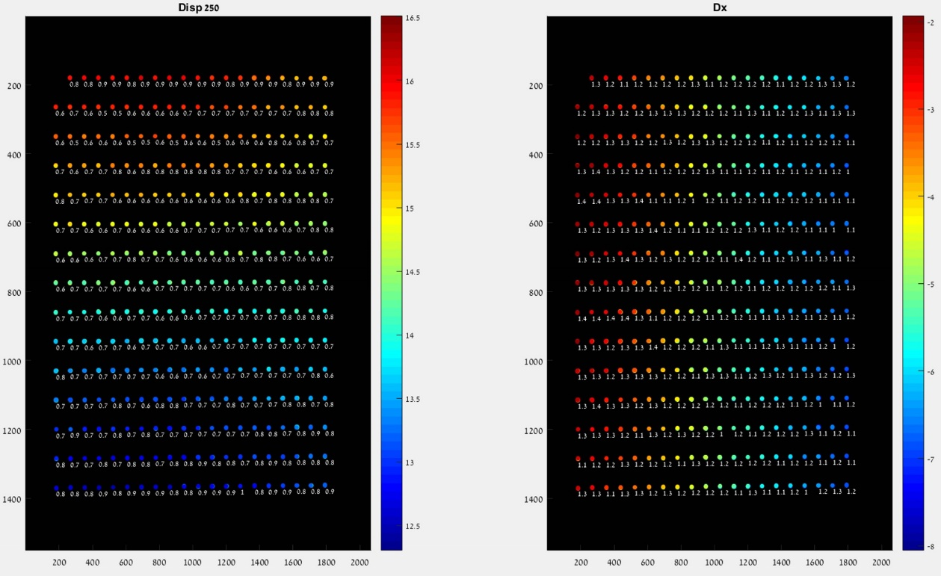
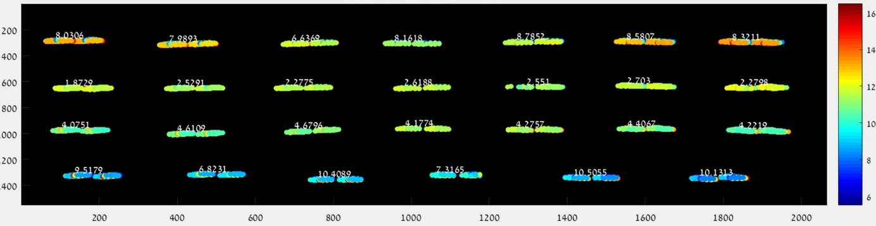
Wide to tele focus mismatch
Difference in relative focus between the cameras causes difference in disparity.
Using manually set focus position.
Each camera focus deviates from the optimal focus, but in an opposite fashion.
Notes:
Next issue- wide to tele focus mismatch.
The case where there is a mismatch in the focus distance between both cameras.
Causes additional scale between the images and thus changes the disparity along the sensor and between different capture for the same scene (as shown in the image on the left, the range per cluster is very high and the total range is also extremely high).
Fix 1: Use manually set focus position (also helps the focus fail).
On the right we can see the result of this (7 manually set focus), the range per location and entire chart range is much decreased though it is still not perfect (especially the chart’s entire range).
We performed several initial experiments and got very low depth estimation accuracy as well as different results for the same experiments done at different times. In this slide we can see the results of a face chart and chessboard chart taken at different times, at the same distance with the same module. As we can see, we can hardly even notice that the depth is the same from the disparity. Since the repeatability is the most important factor in any solution we come up with, we started investigating which factors effect it and tried to come up with possible fixes.
In the right figure we see the disparity range for each point using a manually set focus position for each corner over 7 refocus attempts (setting the manual focus to the same values each time). We can see that even though we set the same manual focus values for each attempt, we are left with two large issues here – each corner’s range is still not negligible but more importantly the flat chart’s disparity range is very high..

Slide 12
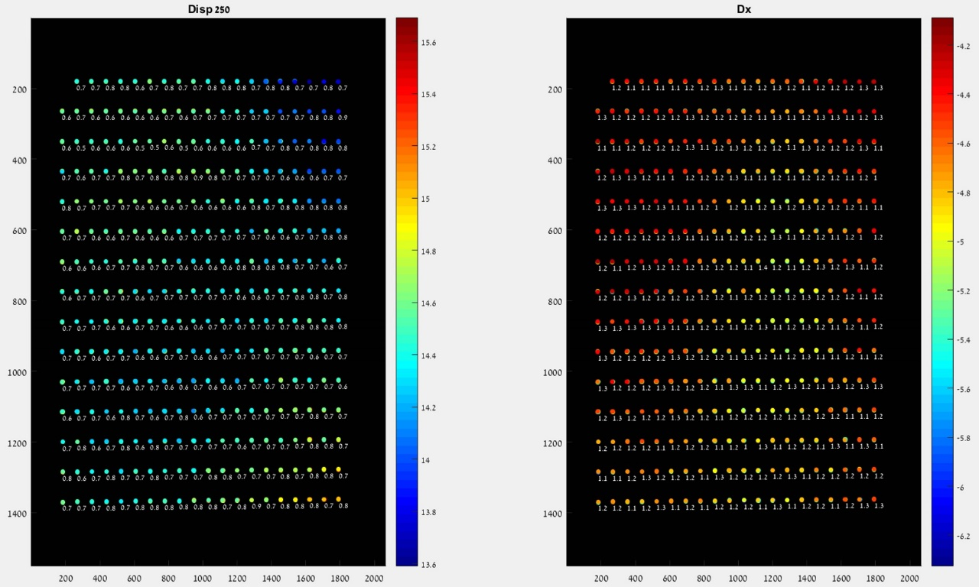
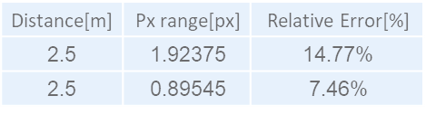
Wide to tele focus mismatch
Difference in relative focus between the cameras causes difference in disparity.
Optimized scale minimization on a flat scene.
Each camera focus deviates from the optimal focus, but in an opposite fashion.
Notes:
Fix: find optimized scale using the non-disparity axis range as a minimization goal.
In the flat experiment, we can see that the per dot range isn’t much improved, however the entire chart range is decrease by 50%.
We found the scale here using an optimization function that is aimed to minimize the non-disparity axis range, this way the offset in that axis doesn't have any real effect and we can theoretically handle depth scenes as well. We see that, while the per corner range decreased only by a little, the chart's disparity range decreased by a lot. This is a favorable result as it would allow us to learn a fix from all the image and apply it to the entire image instead of each section having its own localized fix. The table shows the relative error with learning the fix from only the center of the image and applying it to the rest of the image, before and after the scale correction.

Slide 13
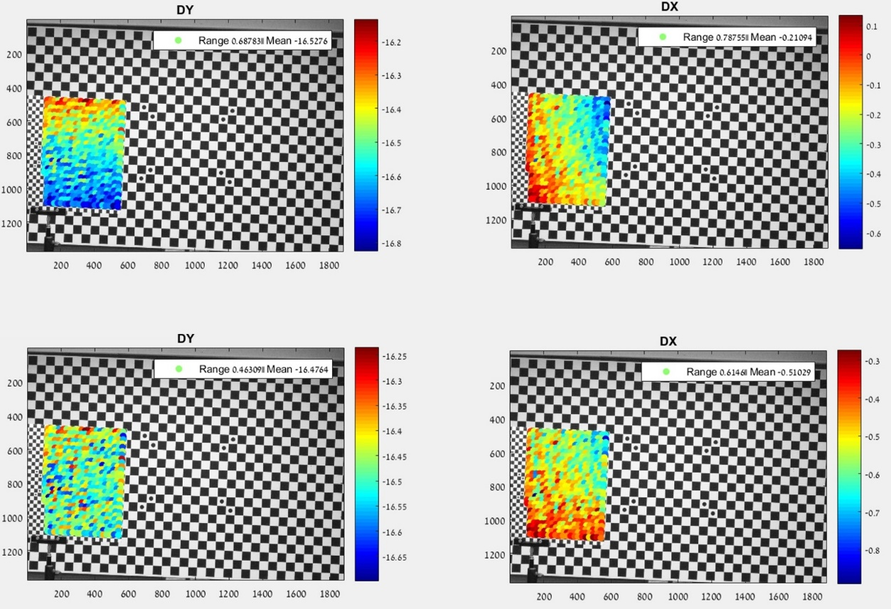
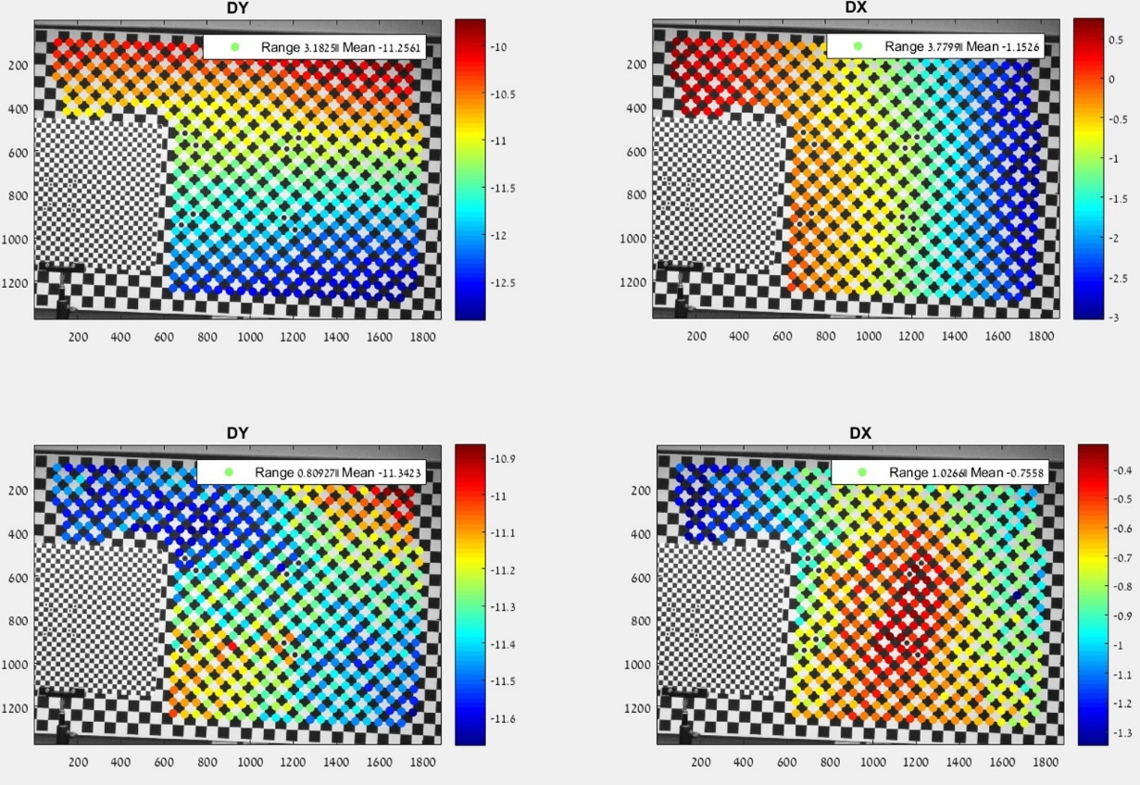
Wide to tele focus mismatch
Test: Optimized scale minimization on a dual depth scene.
Conclusion: There is a need to cluster each depth for scale estimation.
Notes:
Testing the fix on a multi depth scene.
We found that the close chart’s scale is 1.0005 while the far one is 1.0023.
Conclusion – scale is dependent on depth. This is probably due to the Z axis translation (unlike the x,y this doesn’t present as disparity but rather as scaling per depth, as we see here).
Solution: cluster features by disparity before optimizing scale. This fixes both the w-t scaling and the Z translation scaling along the way, however is requires a sufficient amount of features per depth.
In these figures we can see the results of using the optimized scale option we mentioned before on a dual depth scene, each depth separately. The scale we got for only the close chart is 1.0005, and for only the far chart we got 1.0023, and if we tried a global scale we got 1.0019. As we can see, each distance has its own different scale, and the combined one is probably influenced only by the amount of points each chart has in the image, rather than one true underlying scale (the far one has obviously more points, so it has a greater influence on the combined scale). This is probably caused by the translation in the Z axis, which causes each depth to have a different scale factor and this, in turn, makes the task of finding the "correct" scale factor, so that the wide and tele images will be at the same scaling in regard to each other in every image taken, very difficult.
We propose to cluster features according to disparity and fix each disparity's scale independently, i.e. fix each depth's scale, and this way we can apply this method to both the learning and the application phases and increase repeatability. This also fixes the Z translation problem along the way. However, for scenes where there is only a limited amount of points for a certain disparity value, or if their spread is limited then the fix could be very biased and incorrect.
We conclude that for flat scenes, or if we have a sufficient spread of the desired object's disparity cluster in the image, we can use the wide to tele scale fix to be able to fix the entire image from a small amount of data. However, for a depth scene, we would probably need a localized wide to tele fix per depth.

Slide 14
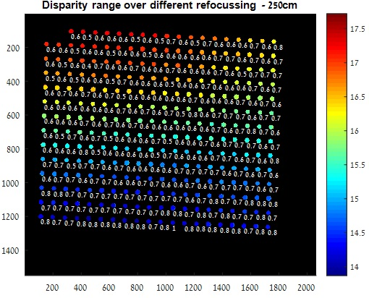
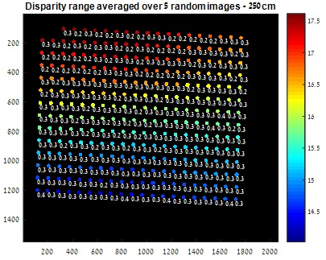
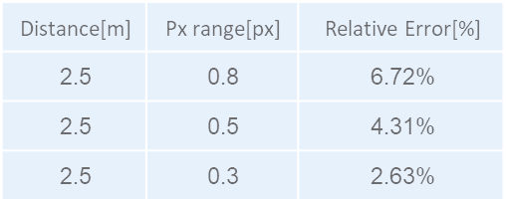
Same camera focus repeatability
Same camera focus changes for the same depth between different captures.
Averaging over several focus attempts.
Notes:
Next focus issue : same camera focus repeatability.
Even if W-T focus is fixed, each camera can focus differently on a scene with the same depth and cause changes in disparity.
The figure on the left shows the same dot range is still not negligible.
Fix : averaging disparity over focus attempts. 3 attempts averaging reduced the maximal per dot range to 0.5, while 5 reduces to 0.3.
Issues: need to match features between all images average and the fix is only for the matches features and not the entire scene. This removes a large amount of features (slightly different angle, focus etc…).
Even if the focus between the wide and tele is fixed, since we don't have any "real world size" in a normal scene, we don't know if the focus is correct for the desired object in the ROI. It could be that one focus attempt chose to focus a bit farther away and the other a bit closer. This causes some extra disparity difference for the same object distance in the same sensor location.
The figure in this slide shows the results of an experiment done with manual focus position setting, on a tripod with a flat chessboard scene. As we can see there is a range in the disparity between each corner location even with a tripod and manual focus setting and as we’ve seen before, the wide-tele scale fix doesn’t help with this issue.
Take several images for several focus attempts of each of the learning phase photos and the application phase photos. For each focus attempt, extract the features and find their disparity. Then match the features between all the tele images and all the wide images. For each feature, average the disparities found. The figure in this slide shows the results of the same experiment as before, with averaging the disparity over 3 and 5 focus attempts (chosen randomly from our set of 7 attempts), and the resulting ranges. In the table we summarized the effect of averaging the disparity on the relative error. We can see, that by averaging 3 focus attempts we can get a decent improvement and by averaging 5 focus attempts, we manage to get a large improvement.
Theoretically, this seems like a good fix. However, in the real world scenario, matching a feature across 5 different focus attempts while the cameras moved (even a little) during the refocus attempts is quite difficult. From our handheld experiments we saw that only a small portion of the features in a scene get matched between different focus attempts and most features are dropped since they don't exist in one of the scenes (aren't recognized as features by the extractor), and this naïve fix only works on the features found across all images so using it on a handheld scene will likely only leave a very small amount of features that will be fixed.

Slide 15




Same camera focus repeatability
Assumption: Only difference caused by focusing is a change in focal.
Fix: scale the images to each other.
Find the optimal scale brute force.
Use the essential matrix.
$${\left[\begin{matrix}x_{1} \\ y_{1} \\ 1\end{matrix}\right]}^{T}\left[\begin{matrix}\frac{1}{s_{1}f_{x1}} & 0 & 0 \\ 0 & \frac{1}{s_{1}f_{y1}} & 0 \\ \frac{−O_{x1}}{s_{1}f_{x1}} & \frac{−O_{y1}}{s_{1}f_{y1}} & 1\end{matrix}\right]\left[\begin{matrix}E_{1} & E_{4} & E_{7} \\ E_{2} & E_{5} & E_{8} \\ E_{3} & E_{6} & E_{9}\end{matrix}\right]\left[\begin{matrix}\frac{1}{s_{2}f_{x2}} & 0 & \frac{−O_{x2}}{s_{2}f_{x2}} \\ 0 & \frac{1}{s_{2}f_{y2}} & \frac{−O_{y2}}{s_{2}f_{y2}} \\ 0 & 0 & 1\end{matrix}\right]\left[\begin{matrix}x_{2} \\ y_{2} \\ 1\end{matrix}\right]=0$$
$${\left[\begin{matrix}x_{1} \\ y_{1} \\ 1\end{matrix}\right]}^{T}\left[\begin{matrix}\frac{1}{f_{x1}} & 0 & 0 \\ 0 & \frac{1}{f_{y1}} & 0 \\ \frac{−O_{x1}}{f_{x1}} & \frac{−O_{y1}}{f_{y1}} & 1\end{matrix}\right]\left[\begin{matrix}\frac{1}{s_{1}}\frac{1}{s_{2}}E_{1} & \frac{1}{s_{1}}\frac{1}{s_{2}}E_{4} & \frac{1}{s_{1}}E_{7} \\ \frac{1}{s_{1}}\frac{1}{s_{2}}E_{2} & \frac{1}{s_{1}}\frac{1}{s_{2}}E_{5} & \frac{1}{s_{1}}E_{8} \\ \frac{1}{s_{2}}E_{3} & \frac{1}{s_{2}}E_{6} & E_{9}\end{matrix}\right]\left[\begin{matrix}\frac{1}{f_{x2}} & 0 & \frac{−O_{x2}}{f_{x2}} \\ 0 & \frac{1}{f_{y2}} & \frac{−O_{y2}}{f_{y2}} \\ 0 & 0 & 1\end{matrix}\right]\left[\begin{matrix}x_{2} \\ y_{2} \\ 1\end{matrix}\right]=0$$
$$A′\left[\begin{matrix}{E′}_{1} & {E′}_{4} & {E′}_{7} \\ {E′}_{2} & {E′}_{5} & {E′}_{8} \\ {E′}_{3} & {E′}_{6} & {E′}_{9}\end{matrix}\right]=A\left[\begin{matrix}\frac{1}{s_{1}}\frac{1}{s_{2}}E_{1} & \frac{1}{s_{1}}\frac{1}{s_{2}}E_{4} & \frac{1}{s_{1}}E_{7} \\ \frac{1}{s_{1}}\frac{1}{s_{2}}E_{2} & \frac{1}{s_{1}}\frac{1}{s_{2}}E_{5} & \frac{1}{s_{1}}E_{8} \\ \frac{1}{s_{2}}E_{3} & \frac{1}{s_{2}}E_{6} & E_{9}\end{matrix}\right]$$
$$\frac{E_{9}}{{E′}_{9}}=\frac{A}{A′}=B, \begin{matrix}\frac{E_{8}}{{E′}_{8}} \\ \frac{E_{7}}{{E′}_{7}}\end{matrix}=Bs_{1}, \begin{matrix}\frac{E_{3}}{{E′}_{3}} \\ \frac{E_{6}}{{E′}_{6}}\end{matrix}=Bs_{2}, \begin{matrix}\begin{matrix}\frac{E_{1}}{{E′}_{1}} \\ \frac{E_{2}}{{E′}_{2}}\end{matrix} \\ \begin{matrix}\frac{E_{4}}{{E′}_{4}} \\ \frac{E_{5}}{{E′}_{5}}\end{matrix}\end{matrix}=Bs_{1}s_{2}$$
Notes:
- Under the assumption that the only thing that changes with focus is the focal length.
Fix options:
Find the optimal scale between all the matching features, “brute force”, to minimize the disparity differences. Could be done between all images and one anchor to find most common scale.
Use the essential matrix. Under the assumption that only the focal length changes and some algebra we get that if we calculate the essential matrix under “wrong” focal length by a scale factor we will get an essential matrix that deviates from the expected one as seen below. We can use the essential matrix from the calibration in order to extract the scales, or use one essential matrix from the image set as base.
We tried to find a better solution than the above, in order to be able to handle the real world scenario without holding a bunch of images in the memory all the time and with as little additional calculations on new depth estimations as possible.
We started off with the assumption that the only thing that would change with the focus would be the distance between the sensor and the lens barrel in the Z direction. If that is the case, then the only thing that we need to change in our intrinsic camera parameters would be the focal length. In order to find the scale that is related to the current focus position we thought of a two different approaches:
Normalization to base image - The first, simpler approach, is to take all the wide-tele image pairs from the focus attempts and find each pair's feature matches and disparity. Then, take each tele image and find its feature matches with the first one, and the same with the wide images. From these matches we can calculate the disparity difference between each pair. We then try to find the best scale and offset for each wide image and tele image separately, that will minimize this disparity difference. In this way, we use our first image pair as a base and try to scale and offset all other pairs to fit to it. Since choosing the first image as a base is arbitrary, we try to find the "real" base for each camera from the set and normalize the rest according to it (i.e. dividing all other scales by the base scale and subtracting offsets by the base offset). We decided that to approximate the "real" scale and offset we will choose the median in the set for each value. The possible issue with this solution is that in the case of a handheld camera, the time between focus attempts is small but not insignificant. During this time the handheld camera moves, even if and the user tries to stay as still as possible. This causes some rotation and translation between images from the same camera which could potentially cause a change in the disparity that is not due to scale and offset, but a change due to the actual change in distance. If such a change occurs, this method will try to compensate for it wrongly with different scale and offset than the "correct" one.
The essential matrix - the theoretical solution we came up with relies on using the essential matrix. If we take the known formulation of the essential matrix and use the known properties for inverting upper triangular matrices, we can get the first equation in this slide. Following some algebraic manipulations and our assumption we can see that if we try to estimate an essential matrix under a wrong focal length that is scaled from the real one we will get an essential matrix that is different from the real one as depicted in the bottom equations and we can extract the scales accordingly. The “real” essential matrix we can either get from the calibration or from the first image in the focus stack.

Slide 16
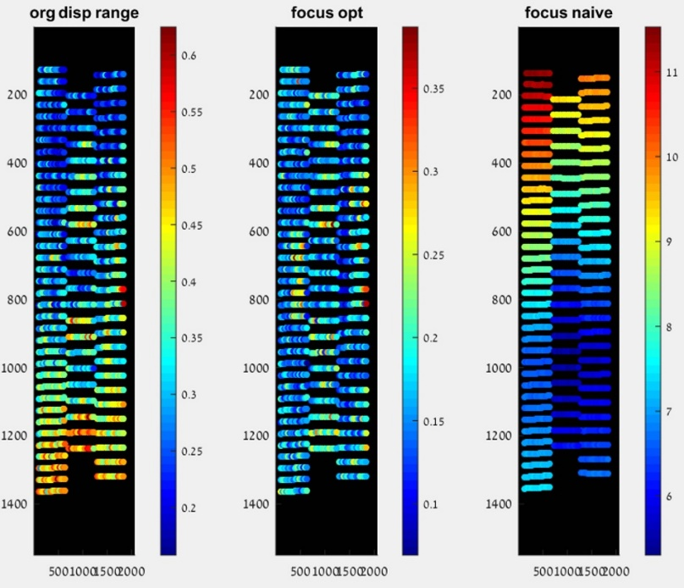
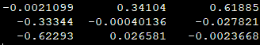
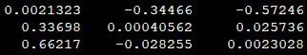

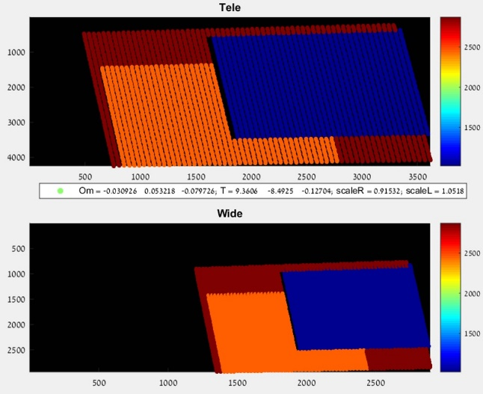
Same camera focus repeatability
Theoretical simulation.
Real world tripod check.
Notes:
We checked our formulation in two settings, the theoretical simulation env and on a real world experiment.
We can see that in the theoretical simulation env, even if we change the orientation of the cameras along with the scale, the formulation holds and we indeed manage to get the scale from the essential matrix.
In the real world case however we can see that we only made the results worse.
This could be due to several reasons:
Optical axis location might change with focus.
Translation between cameras could change due to focus, this is obvious in the Z direction but could also be in the other directions (the focus mechanism movements are not entirely in the Z direction).
Relative rotations between the effective pinholes in the new focus could change.
Other reasons we didn’t think of.
Checking the optimal scale “brute force” however did yield positive results in the handheld experiment showed here (the second plot in the right figure).
The figure in this slide shows the result of a simulated depth scene. On the left we see the original scene, and on the right is the same scene after both cameras went through the same random rotation and translation (so the relative rotation and translation between them remained the same) and a different random scaling for each camera. The simulated scaling for the wide is 1.0518 and for the tele its 0.91532. Above each scene is the extracted essential matrix using the intrinsic parameters from the calibration (i.e. not changing the focal length according to the added scale). Using the equations, we have shown in the previous slide, we get the exact same values for the scale extracted from the essential matrices as the simulated scales. So our theory holds in the simulation environment.
We tested our theory on a real world scene, but still on a tripod, as it is easier to find the real scale value when there is little to no change between the images other than the focus. The figure in this slide shows the results of 5 refocuses, three chessboard at varying depths scene, on a tripod with a heated folded module. We extracted the chessboard corner for each chart and calculated the disparity range for each corner for the original images (left), the optimized scaled images (middle) and the images with scale calculated with the above formulations (right). We can clearly see that the above formulation does not hold up in practice.
We additionally checked other options using the essential matrix (decomposing it and optimizing to get constant angles, translations or any combinations) but none proved to be useful.
The reason our theory doesn’t hold is probably because the base assumptions for what changes with refocusing are probably wrong, most likely more than just the focal length changes. It could be that the result of any number of factors:
- Optical axis location changes (sensor position with respect to the lens barrel).
- Translation between the cameras change. This makes sense, and in fact in the Z axis it's quite obvious since the lenses don't move together. This could also be an issue in the other axis since the lens barrel doesn't move completely in one axis for the focus mechanisms.
- Relative rotation between the cameras change.
Other reasons we didn't think of.

Slide 17
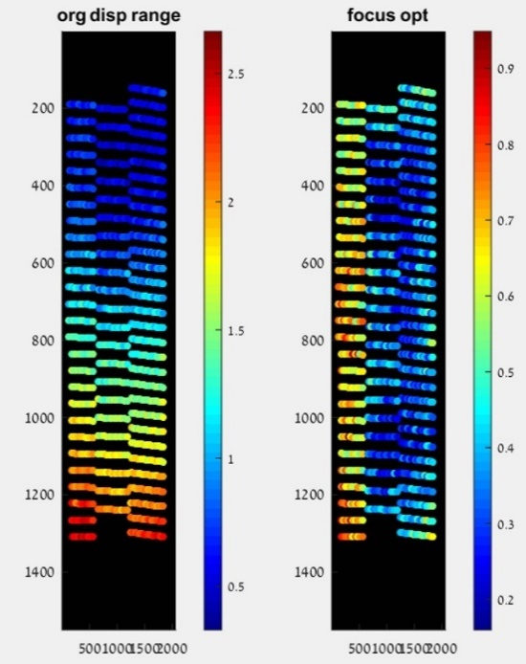
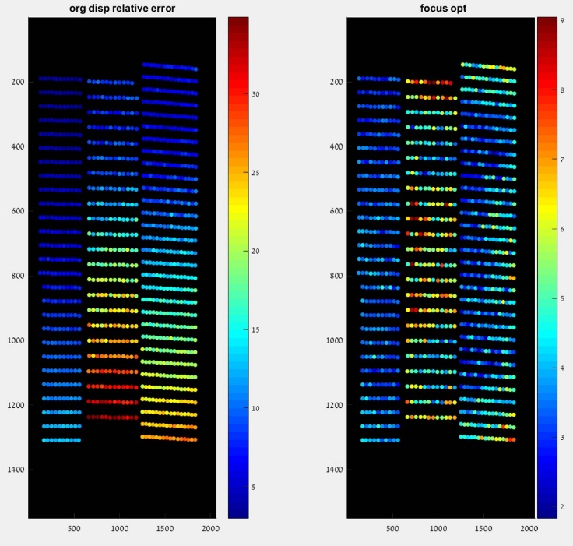
Same camera focus repeatability
Theoretical simulation.
Handheld multi depth scale optimization check.
Notes:
We checked the optimal scale fix on a handheld scene as well (since this was the major risk we feared )
Results seem very good, the only large remaining disparity range is in the close chart which translates to a small relative error (all in all decreased from 31->9).
After reaching the conclusions that we can’t use the essential matrix, we decided to check how much the handheld scenario effects the more basic optimization method (i.e. minimizing disparity differences between 2 tele images). The figure in this slide shows the result of the optimization on the same scene as before only in the handheld case and not the tripod case.
As we can see, the optimization method works very well even in a handheld scenario. We can also see that the only "large" ranges in the disparity are in the closer chart, for which the disparity is larger anyway so the relative error is much smaller. This has the advantage of showing a large improvement on even handheld scenario while not relying on the need to match all features across the entire set of images but even a relatively small amount of matches could suffice to find the optimal scale that will in turn be used to fix the disparity for all the features.

Slide 18
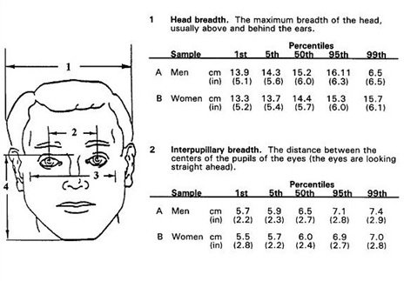

Disparity to depth conversion
Disparity values differs from theoretical expectation.
Use a known world size and online learning
$$\frac{AverageIPD_{\left[cm\right]}∗f_{\left[pixels\right]}}{IPD_{\left[pixels\right]}}=Depth_{\left[cm\right]}$$
Notes:
Up to now we handled the repeatability issues, but there is still the issue with the basic conversion.
Suggested fix – use known real world sizes to “learn” an online offset fix for the conversion.
Could be done per focus, per sensor location if needed.
One such known size could be human faces. On the left we see a study that claims that for males the median IPD is 6.5cm with 3.6 standard deviation and for females it is 6.0cm with 3.5 standard deviation. Using Chebyshev’s inequality we see that we can get within 1mm accuracy of IPD with a sample of around 13 people of the same gender with ~1% probability.
If we use facial landmark extraction and get the IPD in pixels and the disparity we can learn a fix from the face chart and reduce the error from 29.5% to under 4.5% if we try to get the closest correction to each point (could be even better if we get more faces with better spread).
Using an offset learned only from the middle face can still reduce the error to 5.5%, with a much reduced need for the amount of faces.
All the previous fixes are mostly in order to get repeatable disparity for different objects at the same depth in different scenes and exploring whether the same sensor location is needed or not. They do not, however, deal with the underlying issue that is the conversion from disparity to depth.
As we can see in the figure in this slide, even if the results are entirely repeatable, there is still a large error when trying to use the basic stereo theory for the conversion. This could be caused due to several different factors:
The calibration minimization function does not attempt to minimize the depth estimation from the stereo images.
The calibration process is done with only one focus distance, which is very close (60cm). This could be an issue for several reasons:
Close object's disparity is quite large anyway, so the relative error is small even for a set offset (which will not be the case for farther distances).
As we've seen in our investigations, the disparity results could vary between different refocusing, even for the same distance, so using only one focus attempt could be unstable.
Focus change effects are not linear with distance. For example, the change between 60cm focus and 120cm focus is much more noticeable than 120cm and 180cm. So taking only a very close focus distance could be a very bad estimate for the normal use case scenario since most natural images are taken at a farther distance, and the calibration parameters are effected by the focus but, as we mentioned before, are not adjusted to different focuses.
The temperature of the modules isn't regulated, i.e. the calibration isn't done with heated modules. We've seen how this could affect the disparity, and therefore the extracted module parameters.
Our calibration is done with a 3D chart that is not close to flat. This could be an issue as we've seen that the depth of the object has an effect on its scale and non-disparity axis error (which is a part of the minimization process).
The first fix option would have been to create a more elaborate and extensive calibration process (i.e. several distance calibration, several temperature calibrations, several focuses etc..) but as we discussed previously this has a severe effect on the production line and is therefore unviable.
The viable fix option we thought of is using an online learning algorithm and a known world size, find the required fix for each disparity and sensor location to convert it to depth accurately during the normal camera operation. One such known size could be human faces. The figure in this slide shows the result of a study done in America on some common sizes in an adult face, and specifically the IPD (interpupillary distance). The study claims that for males the median IPD is 6.5cm with 3.6 standard deviation and for females it is 6.0cm with 3.5 standard deviation. Using Chebyshev’s inequality we see that we can get within 1mm accuracy of IPD with a sample of around 13 people of the same gender with ~1% probability. We note that the study was done on Caucasian adults, so we would need a system to identify age (at least in a binary sense, adult or child), gender and probably ethnicity. The system will probably be comprised of a neural network (possibly two) and we will discuss more about it in the future work section.
If we use a landmark extraction method, locate the IPD in pixels and use the known average we can get a naïve depth estimate, as shown in the equation here, and use it along with the found disparity to find a naïve fix, a simple offset correction. With a large enough amount of faces this fix will indeed converge to the correct fix.

Slide 19
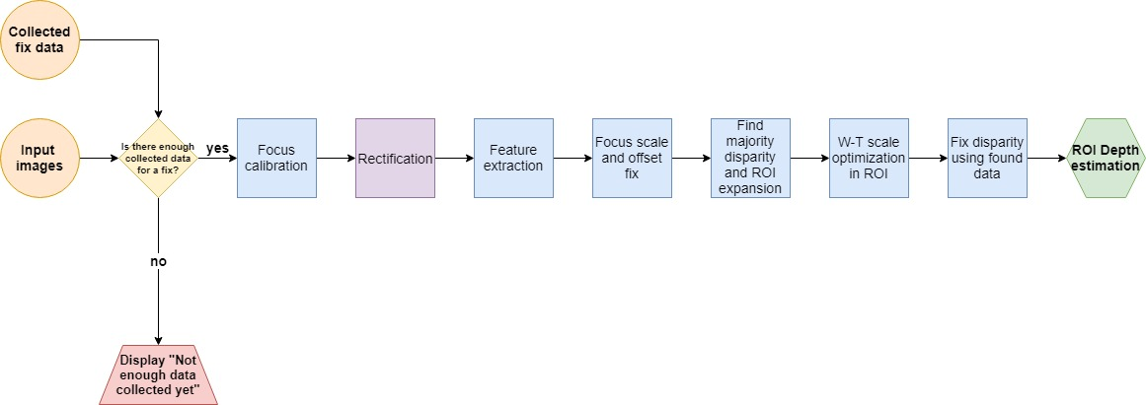
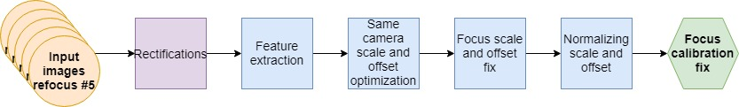
Conclusions
Limitation
Suggested Flow
Fixed focus position
Focus calibration
ROI specific depth
Heated modules
Face chart
Offline training
Notes:
We’ve shown there are a lot of issues and we suggested fixes for most of them but some we weren’t able to handle.
We now summarize our work and suggest a flow for depth estimation under some limitations:
Fixed focus position (around 1.5m)
Focus calibration per acquisition (as described in the flow)
ROI specific depth (to avoid the different depth-scale issues, we will only work on one ROI and use majority disparity)
Heated module
Learning from face chart and offline training.
As we have shown here, there are a lot of issues that we face when we try to get an accurate depth estimation from the disparity of mobile stereo images, starting from module heating all the way to focus issues. We have suggested fixes for most problems, however there were still some issues for which we don't have a fix without more accurate information from the camera module itself. So before we suggest our fix flow we first mention its limitations that we were not able to overcome.
Limitations:
Fixed focus position – as long we don’t have a reliable focus position report we simply choose a value for both camera's focus position so that 1.5m is in focus. Applying this restriction limits our ability to fix close items mostly, but as we mentioned before, their disparity is larger anyway so it has a lesser effect there. For the far off items, the focus difference isn't too large (it's not linear with distance, and most of the difference is from small distances to slightly larger ones) and we think that the most common use case will be for a "normal" distance range of 1m-4m.
Focus calibration – as we have seen, the above restriction does indeed help to limit the disparity but does not solve the issue entirely. In order to further improve the repeatability, we add a focus calibration phase to both our learning phase and the application phase.
The focus calibration phase consists of:
Refocusing to the fixed manual focus position 5 times and retaking captures at each time.
Use the fix option described before to find the scale between each tele image and the first.
After we find all the scales for all the images and find the median one, we correct the final image to fit that scale.
Set the application to “focus lock mode” from that point on so that the focus won't change.
This is our way of finding the most likely scale correction for our scene using several focus attempts and their median scale, and then fixing this scale without allowing any more focus changes to improve repeatability.
ROI specific depth - In order to limit the issues with different depths having different scales, we decided to output the depth of the chosen ROI only (of course the chosen ROI could contain multiple depths, in this case we will output the majority depth) and not a dense depth map. This will enable us to find a scale correction that is suitable to this specific depth (as we have mentioned, due to the Z axis translation, there is a different scale per depth). In this manner, if we apply the same procedure to the learning phase and the application phase, we could help alleviate some of the wide to tele focus issues.
Heated modules - Due to the issues we have seen we will only enable our learning and application phases after the cameras are sufficiently heated. This means that with our folded module we will require the camera application to be active for 3 minutes before allowing for our application to run.
Face chart - For our initial flow, we decided to focus on the fixes themselves and not on the statistical learning convergence, since real faces obviously have some variance in IPD. For this purpose we decided that our learning phase will use images of the face chart, to get multiple faces in each image as well as to eliminate errors caused by the variance.
Offline training - We additionally chose to do all the learning phase offline since our goal is proof of feasibility and the learning phase was not the focus of our research.

Slide 20
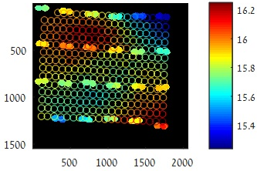
Results and Future work
Results
Reduction of relative error from 30% to 4.5% under some strict limitations
Repeatability
Future Work
Online learning flow
Limitation reduction
Physical improvements
Combining with existing methods
Learned fix
Notes:
We can see that the repeatability is much improved, to the point that learning a fix from faces is viable.
We can see that the learned fix improves the results by a lot.
Future works
we can see the improved repeatability of our flow. From results that show little to no similarity we achieved a very repeatable result that will enable us to use the fix from depth on a general scene.
Once the results are repeatable, we can use the learned fix and apply it to each point and reduce the relative error from ~30% down to +- 4.5%.
As we’ve mentioned, our flow works well but under strict limitations. An obvious line of future work involves trying to solve these limitations, whether by adding more accurate reports from the module, using other sensors in the phone (gyro etc…) or finding other ways to deal with them.
Another line of future work involves physical improvements to the module. Whether by adding an additional wide FOV camera with fixed focus to act as a scale anchor or using a more robust module that is less affected by temperature.
Lastly, we can combine our solution with existing method, such as structure from motion of NN depth estimation and use them to create a robust dense depth map.

Slide 21
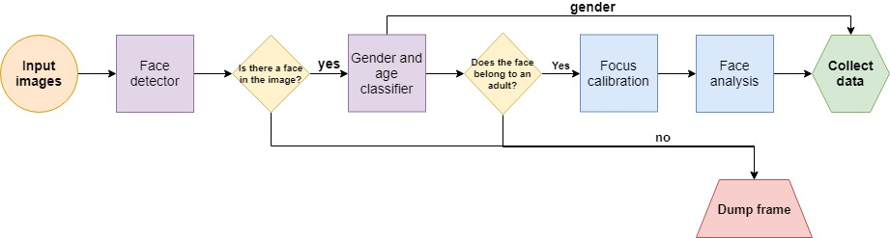
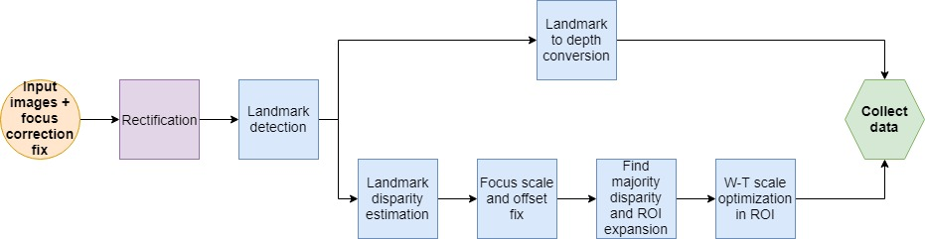
Future work – learning phase flow
Notes:
Our priority in the future work is to create the learning phase. Here we can see our suggested flow for it. It comprises of a NN to classify age and gender (and possibly ethnicity) along with a face detector.

